Slide 1
SELF-INTRODUCTION
Presented by Kent Nguyen

Slide 2
Agenda
Personal information
Education background
Working experience
Plan after joining LG

Slide 3
Personal information
Name: Nguyen Duc Anh (Kent Nguyen)
Date of Birth: 22-07-1993
Address: Tan Xuan-Xuan Dinh-Bac Tu Liem-Ha Noi

Slide 4
Education
Duration time: Electric Power University of Hanoi.
Major: Electronic and Telecommunication.
Degree: Bachelor.
GPA: Good.

Slide 5
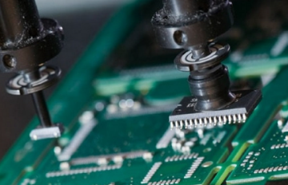


Working experience
Canon Vietnam (July 2016 – January 2020)
Position: SMT Process Engineer
Product : PCBA of Canon printer
Key Mission :
SMT Technology
Improve Process
Control Quality
- Programming for Mounter.
Study and evaluate new SMT model.
Prepare Specification of Process, Machine , training for related group.
- Control IFC index of SMT Process → get activities to improve defect rate, scraps PCB, loss component, inspection cost .
Build system control IFC by VBA coding.
Improve process by VBA coding
Monitoring and control production quality.
Analysis Data from machine to improve performance of machine and quality of production

Slide 6
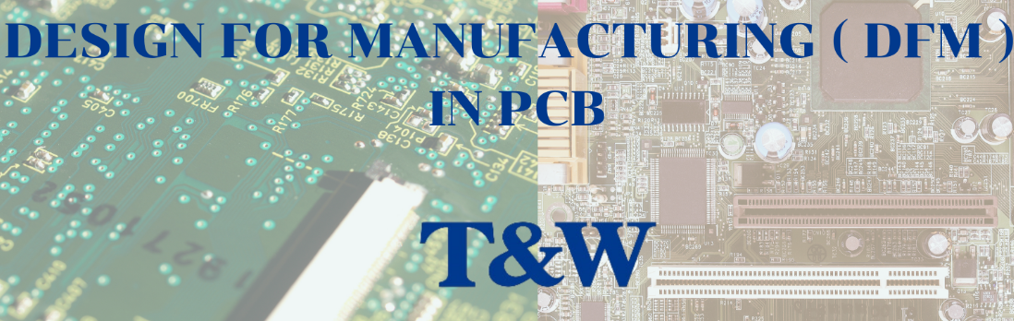
Working experience
Fushan Technology Vietnam December 2019 – December 2021)
Position: SMT Engineer
Product: PCBA for Pixel mobile of Google customer
Key Mission :
SMT Engineer
DFM Engineer
- Make and control program for all SMT machine.
Control quality of all SMT line.
Improve process and quality by build VBA systems.
Make system to control standard of Machine, process.
Prepare condition , evaluate new model of product.
Audit Work Instruction, Machine Standard in line, feedback for related issue.
Control defects of SMT line, analysis, investigate issues and make FA report.

Slide 7


Working experience
Koh Young Technology Vietnam (January 2022 until now)
Position: Software Quality Assurance Engineer
Product : SMT machine (AOI, SPI, RtoS , Review Station of Koh Young , Ksmart Web)
Key Mission :
Manual Test
Automation Test
- Build Test Plan, Co-operate with R&D to prevent Customer Software Issue. - Create/Modify manual test cases and related documents for Web and App. - Upload defects of Web, App to Jira system, handover to developers. - Perform daily smoke tests / regression tests
Create Automation Script by C#/ Ranorex for Web (Ksmart Web) and App (AOI , SPI , RtoS ).
Apply Python – Selenium for Automation Project of Web (Ksmart Web).
Maintenance Automation System (Jenkins System).

Slide 8
Plan after joining LG
Short Term Plan :
→ Have to effort study about domain knowledge ( Automotive testing) as soon as possible because domain knowledge is extremely important with testing . → Always study from colleagues about job, company’s culture , to become a part of LG’s community.
→ Try to become expert in manual test field , contribute the good quality for product . No issue feedback from customer .
→ Can Apply programming (VBA, C# , python) to improve process of testing in near future.
Long Term Plan:
→ Have opportunity to work in automation test role.
→ Can become expert in both of Manual test and Automation test.
→ Have chance to promotion in our company.

Slide 9
Thank you for listening

